Slide 1
Day 2: Prometheus Session 1
By Ramprakash Senthil

Slide 2

About Prometheus
Was started in year 2012 at SoundCloud
Later on, it joined the cloud native computing foundation and in year 2016, it become the second hosted project of cloud native after kuberenetes
Licenced under apache 2.0 licence
Very active developer and user community around the globe

Slide 3
What is Prometheus
Prometheus is an open-source systems monitoring and alerting toolkit with an active ecosystem
It is tool that allows you to analyze how your applications and infrastructure are performing from the metrics discovered it
Prometheus components are written in GO language
Uses a ‘multi-dimensional’ data model with ‘time-series data’ identified by ‘metric name’ and key/value pairs
Example: http_requests_total{method=”get”}

Slide 4
Features of Prometheus
Uses a very simple query language PromQL
PromQL is a read-only and flxible query language, that allows aggregation across any of the labels and its time series
No reliance or distributed storage; single server nodes are autonomous
Default libraries and servers are available for prometheus - Windows, Linux machines and MySQL etc..,
To monitor custom services, you can add instrumentation to your code, via prometheus client libraries like go, python, java or scala and many more..,
Full fledged monitoring system along with its own Alert manager

Slide 5





Alternate Monitoring Tools which available in market

Slide 6
Basic Teminologies of Prometheus
MONITORING: It is a Systematic process of collecting and recording the activities taking place in target project, programme or service and then using that recorded values to check if the targets are reaching their objectives or not
ALERT/ALERTING: An Alert is the outcome of an alerting rule in Prometheus that is actively firing. Alerts are sent from Prometheus to Alert manager
ALERT MANAGER: The Alert manager takes in alerts from prometheus server, aggregates them into groups, de-duplicates applies silences and then sent out notifications to email, pagerduty, slack, etc..,

Slide 7
Basic Teminologies of Prometheus
PROMETHEUS
ALERT MANAGER
EMAIL or SLACK or PAGERDUTY
TARGETS: A Target is the definition of an object to scrape, Target is an object whose metrics are to be monitored.
INSTANCE: In prometheus terms, an endpoint you can scrape is called an Instance

Slide 8
Basic Teminologies of Prometheus
JOB:
Job is a collection of targets/instances with the same purpose
For example: api-server instance: 1.2.3.4:80 instance: 1.2.3.4:81 instance: 1.2.3.4:82
SAMPLE:
A Sample is a single value at a point in time in a time series
For example:
http_requests_total {method=”get”} => 32

Slide 9
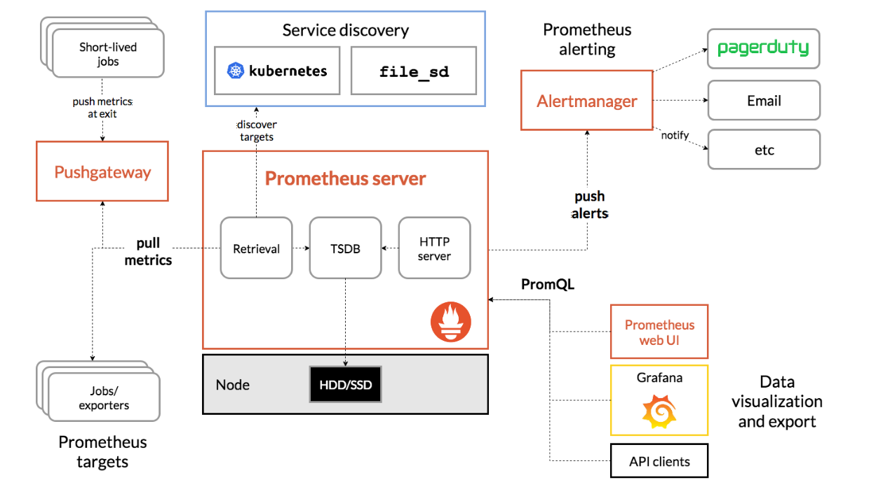
Architecture of Prometheus

